Slide 1
Demand Forecast using Random Forest
Presented by NBAx
Pallavi, Mei, Crystal, Daria, Sarah
March 9th, 2018
Notes:
Daria

Slide 2
Agenda
Introduction to Tree-based Regression
What is Random Forest?
Drug Store Sales Prediction
EDA
Implementation
Results
Further Improvement

Slide 3
Regression
Predictor Variable:
x
Continuous
Response Variable:
y
Goal of Regression:
Predict the values of y for new value of x
Understand the relationship between x and y

Slide 4
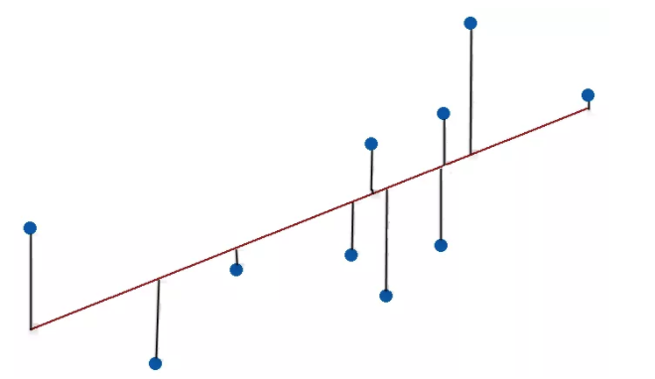
Regression Methods
Simple/Multiple Linear Regression
Nonlinear Regression
Nonparametric Regression
Nearest Neighbor Classifier
Trees
1984 “Classification & Regression Trees”
Breiman, Friedman, Olshen and Stone
Machine Learning Methods
Bagging (1996)
Random Forest (2001)
Boosting

Slide 5
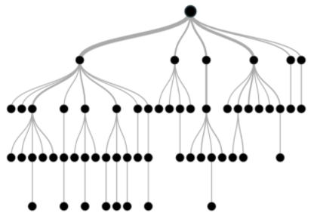

Tree-based Regression
What if the data has lots of features which interact in complicated, nonlinear ways?
Single Global Model? Difficult & Confusing!
Multivariable Analysis: Recursive Partitioning!!

Slide 6
Recursive Partitioning
Repeatedly split the records into two parts so as to achieve Maximum Purity within the new parts.
Information Gain = Entropy (Parent Node) - Weighted Sum of Entropy (Child Node)
RP Algorithm
Pick one of predictor variables, Xi
Pick a value from Xi, say Si, which divides training data into two portions
Measure the purity of resulting portions
Try different values of Xi and Si to maximize purity in initial split
Once you get a “maximum purity” split, repeat the process for a next split

Slide 7




Random Forest
A Divide & Conquer approach using an Ensemble of Decision Trees
Decision Trees suffer from Generalization Error – leads to overfitting
Unstable Tree Stable Forest
Incorporates a mechanism called Bootstrap Aggregating

Slide 8
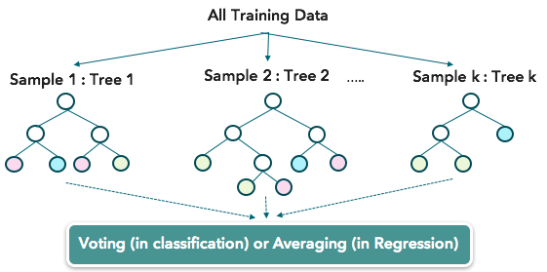
Random Forest

Slide 9
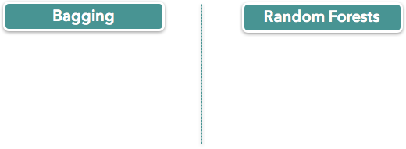
Improvement over Trees
Bootstrap sample : Creates multisets of training data with N’<= N with replacement
Random “N” : Each tree is built using a random sample (R : sampsize)
Feature Bagging : Select random subset of candidate variables to de-correlate the trees
Random “p” : Each split uses a random subset of features (R : mtry)

Slide 10
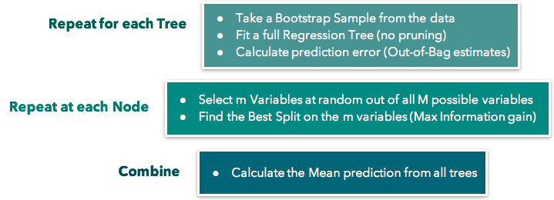
Random Forest - Regression
Take a Bootstrap Sample from the data
Fit a Regression Tree
Calculate the mean prediction of all trees

Slide 11

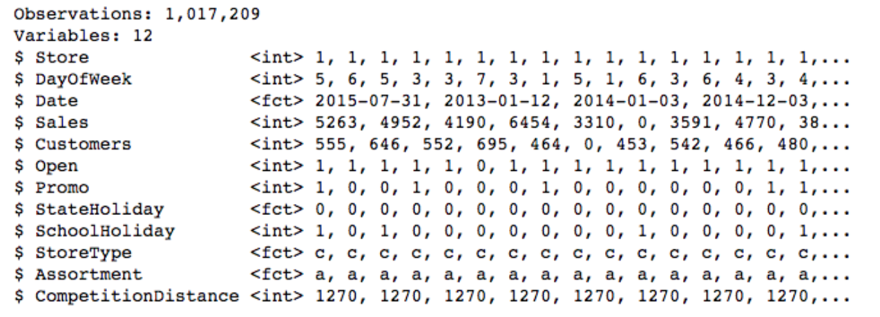
Drug Store Sales
Goal: Predict 1115 drug stores daily sales for up to six weeks in advance use a 3 -year dataset

Slide 12
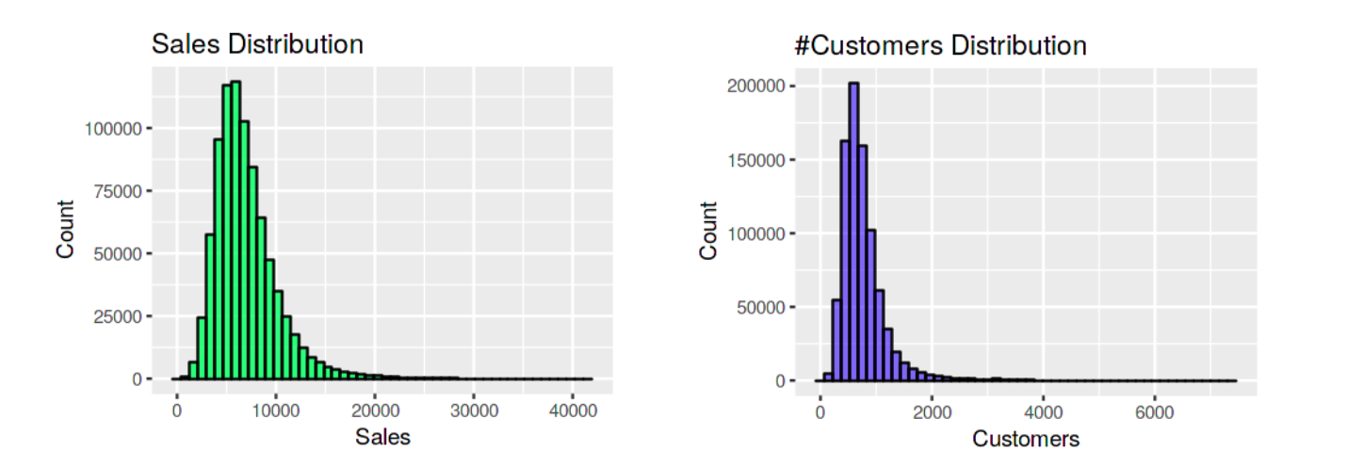
Drug Store Sales - EDA

Slide 13
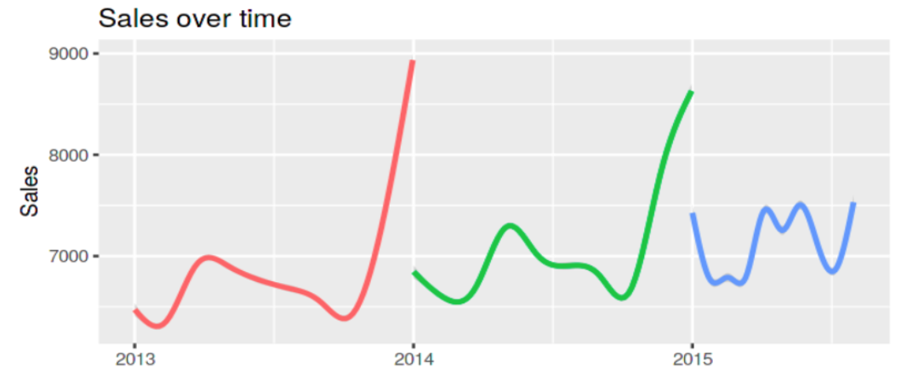
Drug Store Sales - EDA

Slide 14
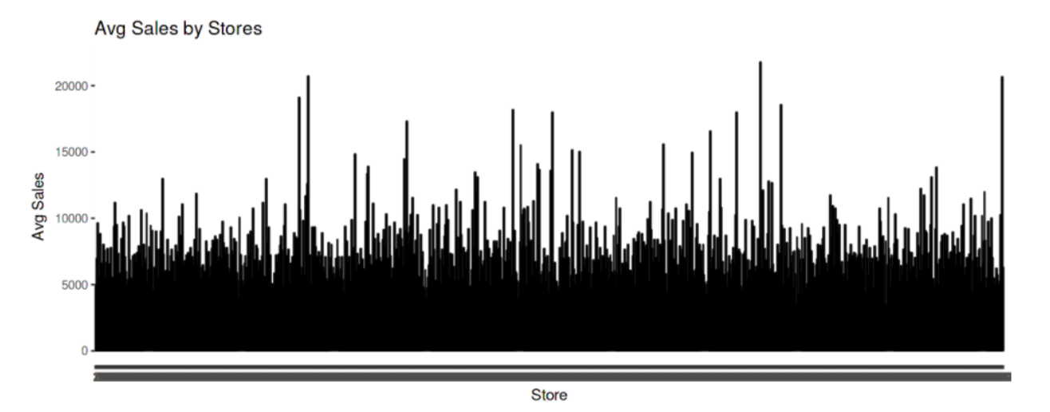
Drug Store Sales - EDA

Slide 15
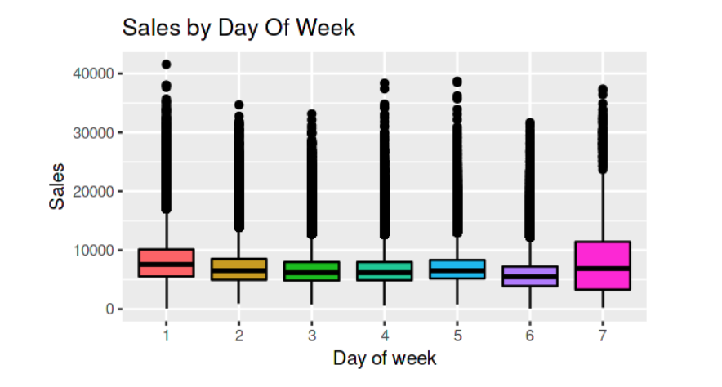
Drug Store Sales - EDA

Slide 16
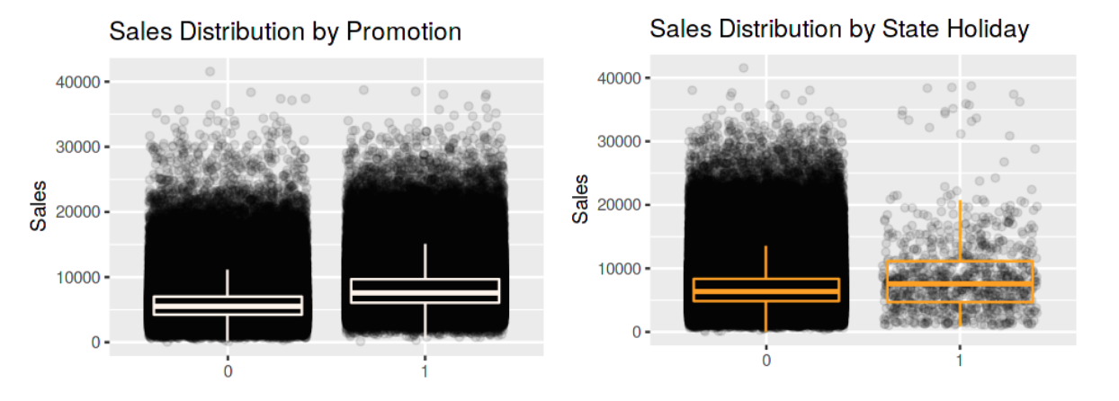
Drug Store Sales - EDA

Slide 17
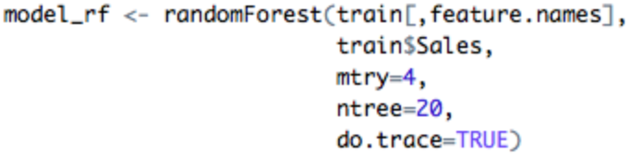
Drug Store Sales - Implementation
Feature engineering
1k+ Stores & Various Sales
Number of customers
Split for Cross Validation
Train: Test = 7:3
Build Model & Assess Performance
Average Sales (unit)/ Month & Store
Average Customers/ Month & Store

Slide 18
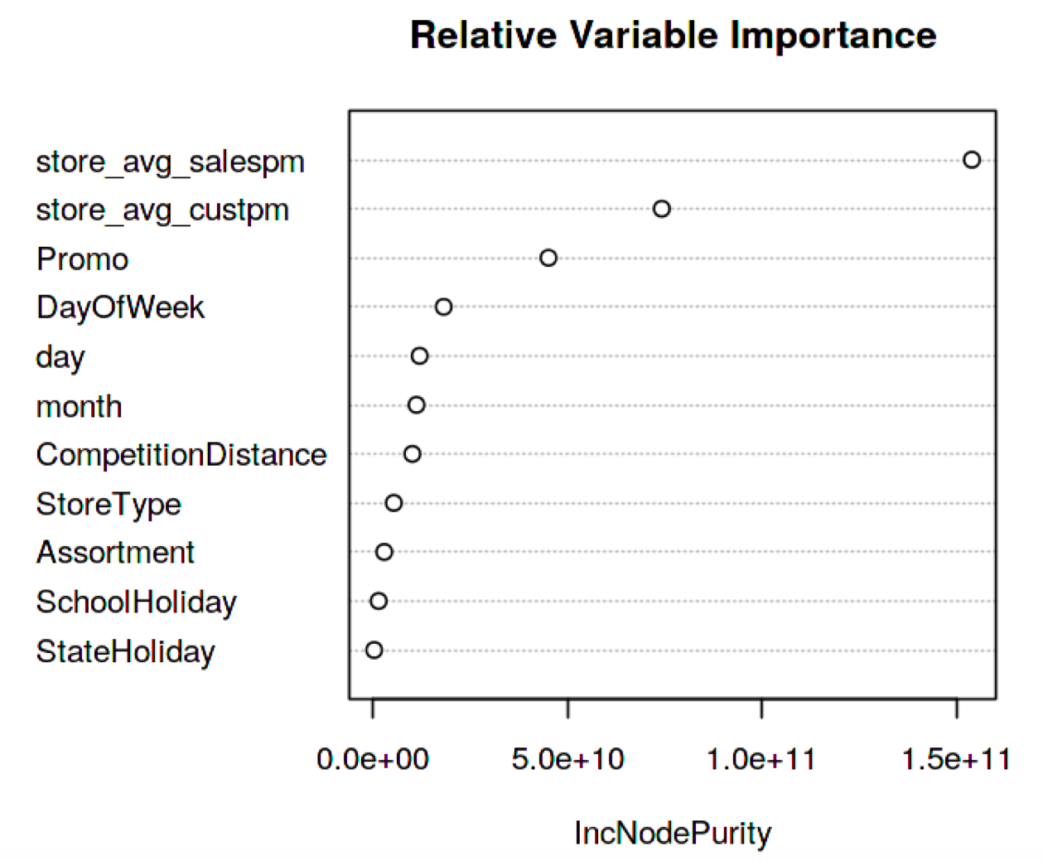
Drug Store Sales - Results
% Variance in Daily Sales Explained by Attributes: ~85%
Most predictive variables: Avg. Sales, Avg. Customers, Promotions, Day

Slide 19
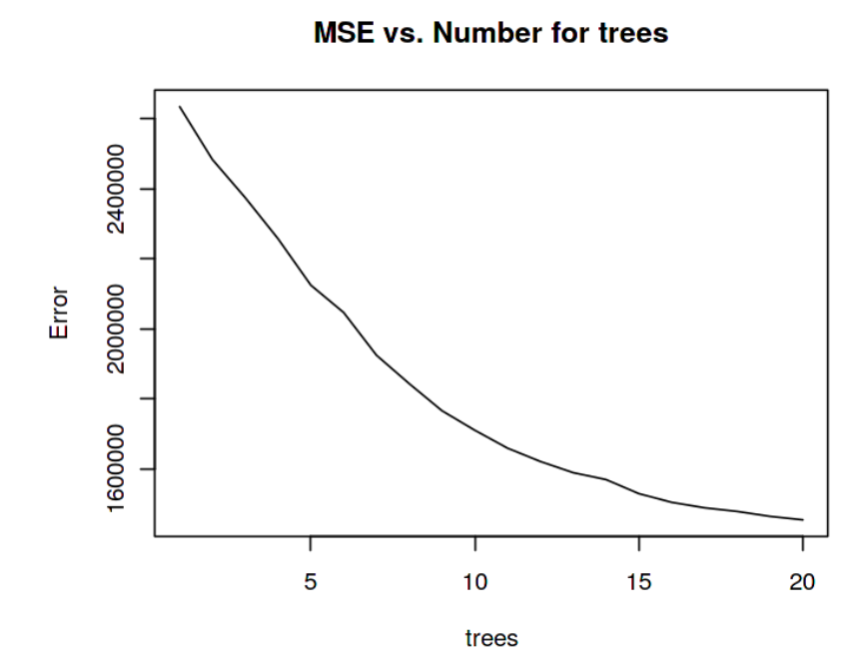
Drug Store Sales - Results
MSE Decreases Exponentially with the Increase in the Number of trees

Slide 20
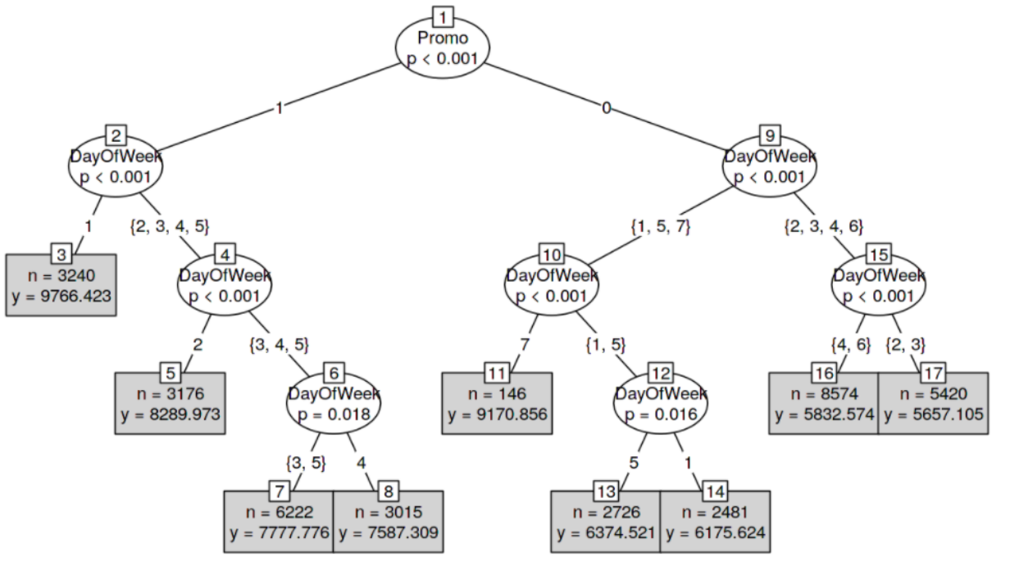
Drug Store Sales - Results
Prediction with two Features: Promotion & Day of the Week

Slide 21
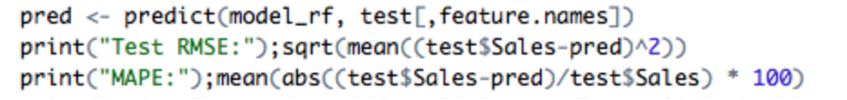
Drug Store Sales - Cross Validation
 | Test | Train
RMSE | 582 | 578
MAPE | 6.08% | 6.04%

Slide 22
Drug Store Sales - Further Improvement
PCA
Dimension Reduction Technique
Useful when: p > N
R Packages: Prcimp, Princomp, PCA
Hyperparameter Optimization/ Tuning
Choose a set of optimal hyperparameters for a learning algorithm
Hyperparameters of RF:
# of Decision Tree, Features, Maximum Depth of Trees
K- fold Cross Validation
R Package: MLR

Slide 23


